Slide 1
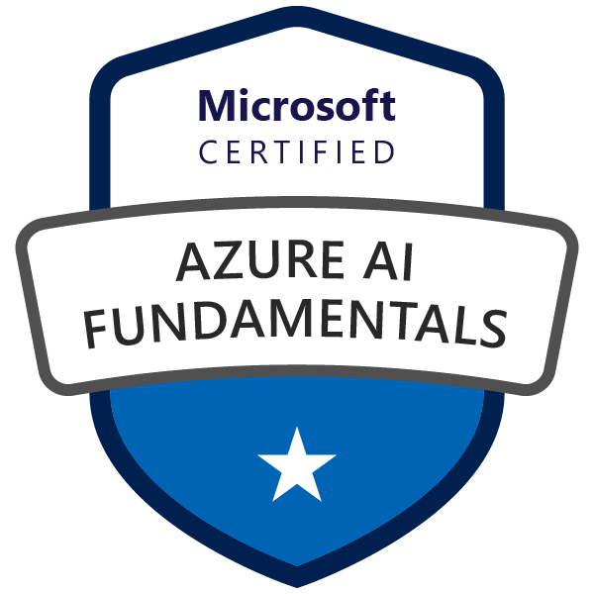
Exam AI-900: Microsoft Azure AI Fundamentals
Tim Warner

Slide 2


Tim Warner
Nashville, TN, US
Microsoft Certified Trainer (MCT)
MVP (Cloud & Datacenter Management)
Twitter: @TechTrainerTim
Badges: timw.info

Slide 3
Session 1 of 2 Learning Goals
Introduction
Describe Artificial Intelligence (AI) Workloads
Review Responsible AI
Describe Machine Learning
Work with Computer Vision Workloads

Slide 4
Session 2 of 2 Learning Goals
Vision
Face
Language
Text Analytics
Translator
Speech
LUIS
Conversational AI Workloads
QnA Maker
Azure Bot Framework
AI-900 practice questions

Slide 5
Session 2 of 2 Learning Goals
Conversational AI
QnA Maker
Azure Bot Framework
Exam AI-900 practice questions

Slide 6
Course Materials
timw.info/ai900

Slide 7

Course Recordings

Slide 8

Course Recordings

Slide 9
Tim's Certification Study Pyramid
Interdependence
Content knowledge
Practical application
Test-taking skills

Slide 10
Expectations
This is a "crash course"
Plan to review these materials more than once
Five-minute break at midpoint
Please ask/answer questions and provide feedback in the Q/A panel, not the group chat

Slide 11
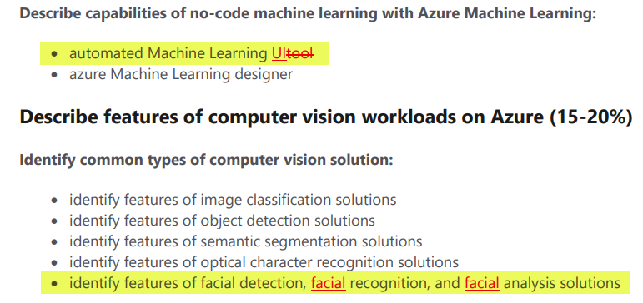
2020 Exam Update Information
Microsoft Worldwide Learning (WWL) revisits the Azure role-based certs yearly
AI-900 updates on October 22, 2020
The updates are trivial and cosmetic

Slide 12
AI-900 Practice Questions

Slide 13
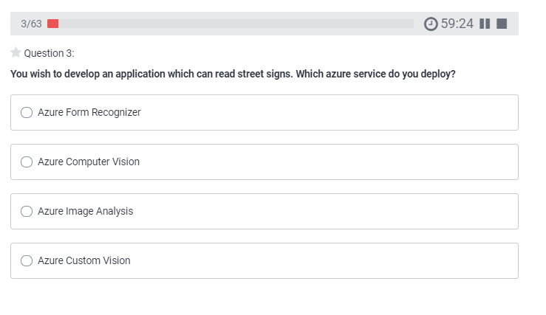
AI-900 Practice Question
timw.info/udemy

Slide 14
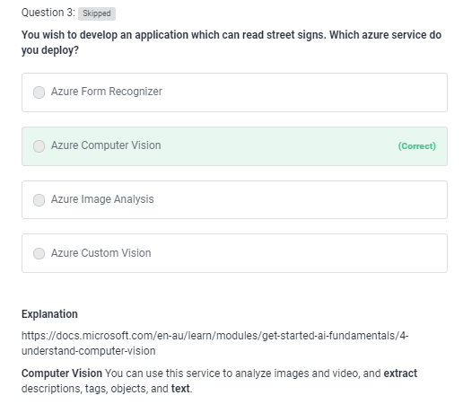
AI-900 Practice Question
timw.info/udemy

Slide 15
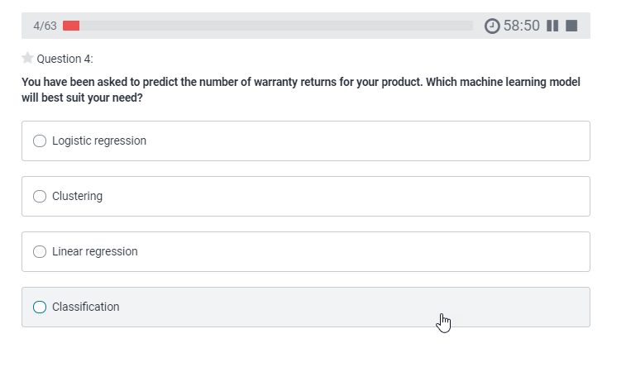
AI-900 Practice Question
timw.info/udemy

Slide 16
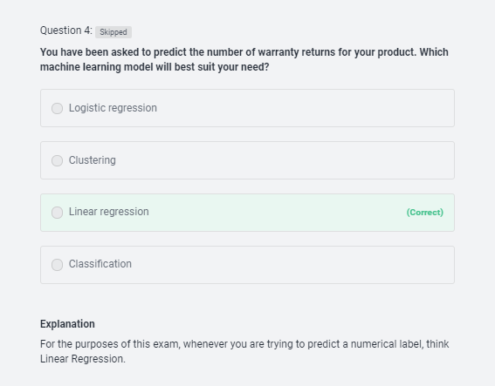
AI-900 Practice Question
timw.info/udemy

Slide 17
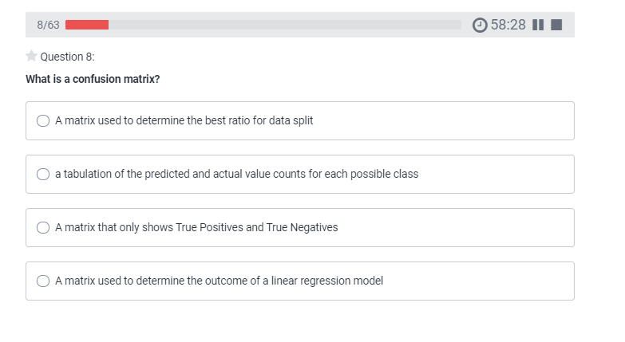
AI-900 Practice Question
timw.info/udemy

Slide 18
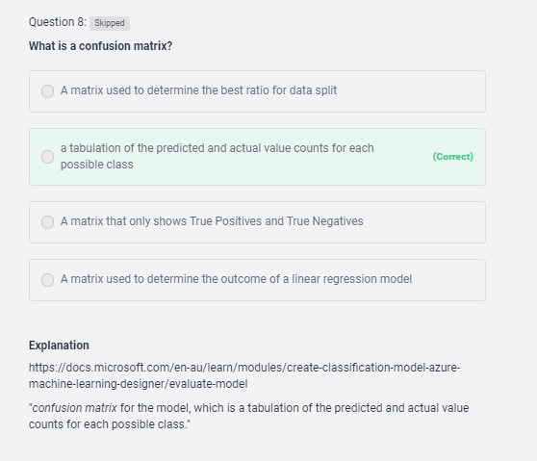
AI-900 Practice Question
timw.info/udemy

Slide 19
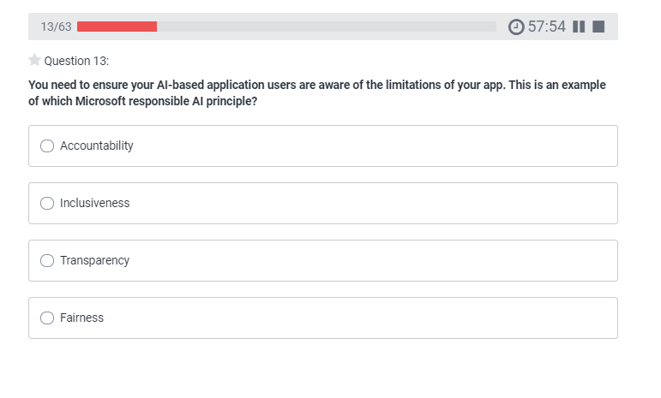
AI-900 Practice Question
timw.info/udemy

Slide 20
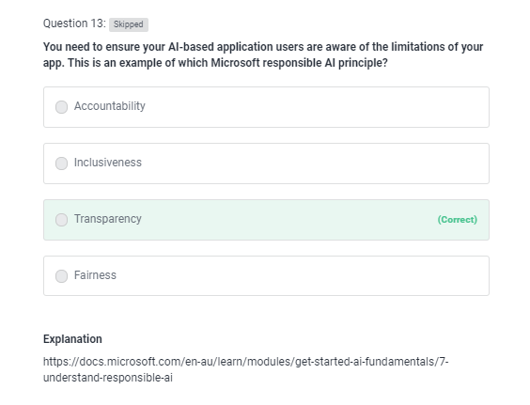
AI-900 Practice Question
timw.info/udemy

Slide 21
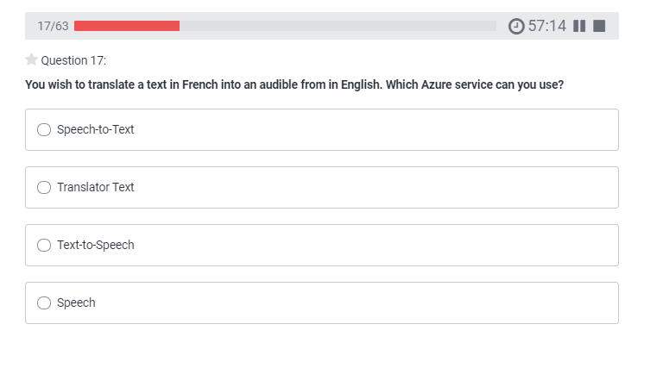
AI-900 Practice Question
timw.info/udemy

Slide 22
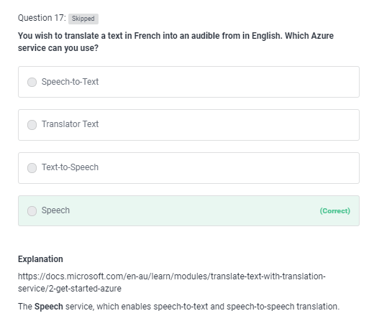
AI-900 Practice Question
timw.info/udemy

Slide 23
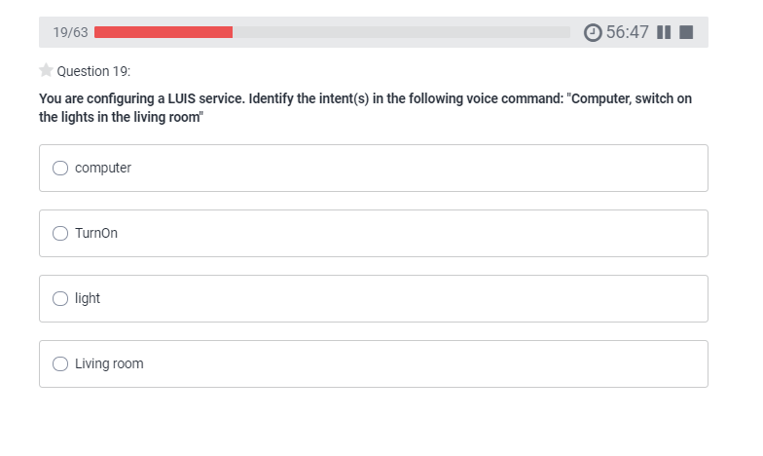
AI-900 Practice Question
timw.info/udemy

Slide 24
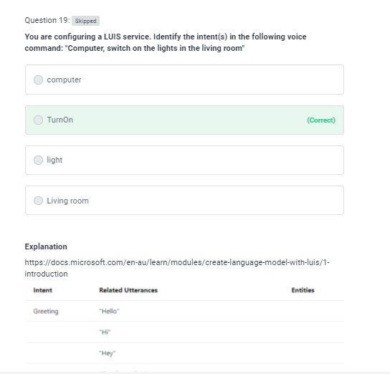
AI-900 Practice Question
timw.info/udemy

Slide 25
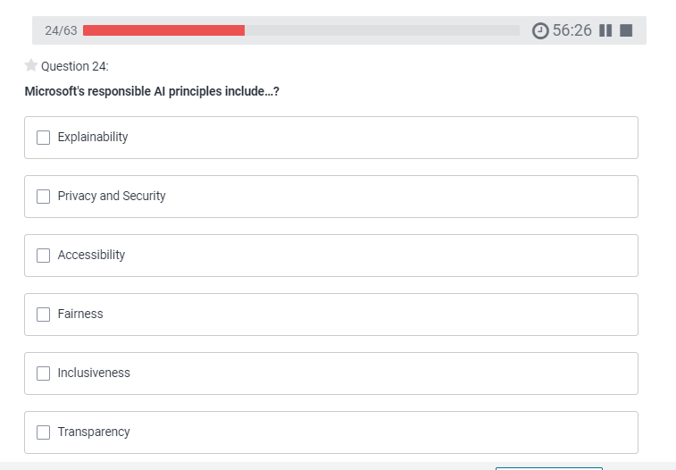
AI-900 Practice Question
timw.info/udemy

Slide 26
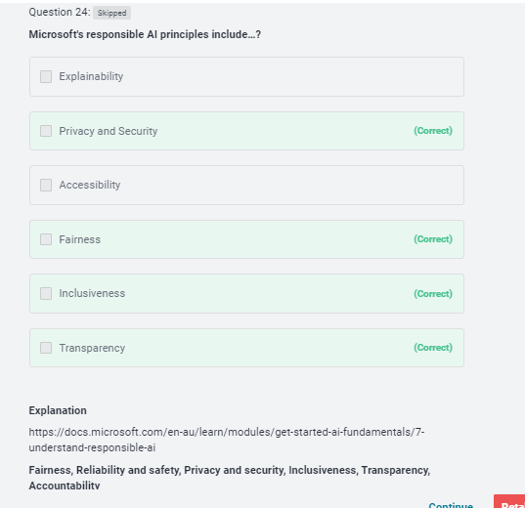
AI-900 Practice Question
timw.info/udemy

Slide 27
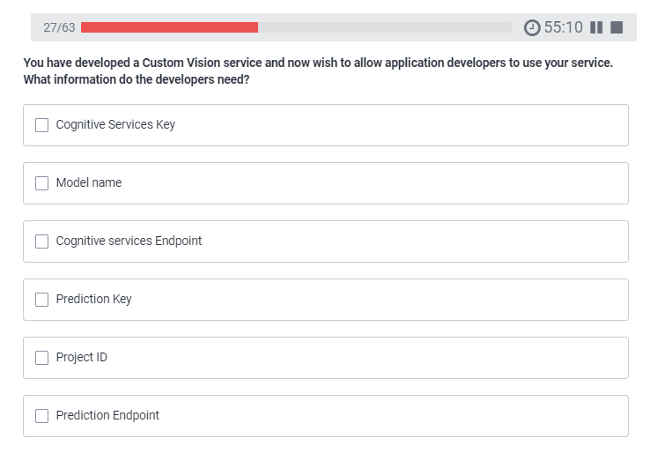
AI-900 Practice Question
timw.info/udemy

Slide 28
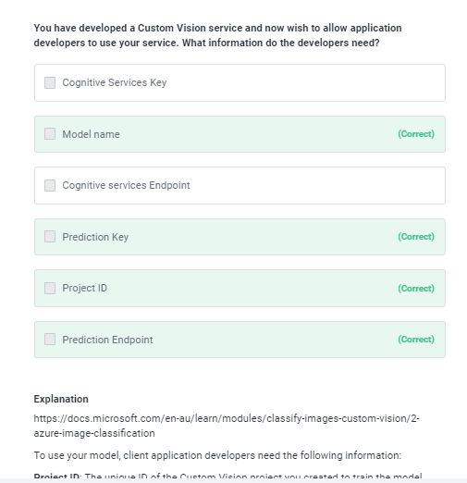
AI-900 Practice Question
timw.info/udemy

Slide 29
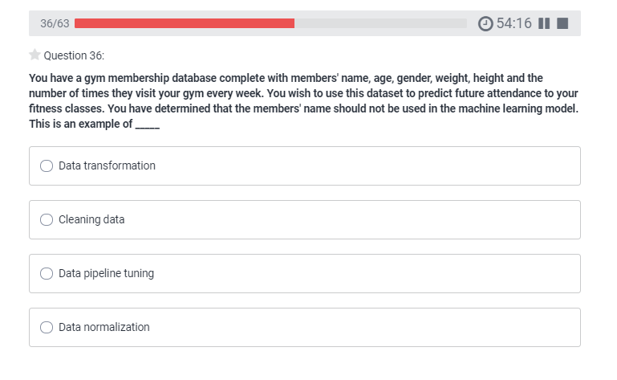
AI-900 Practice Question
timw.info/udemy

Slide 30
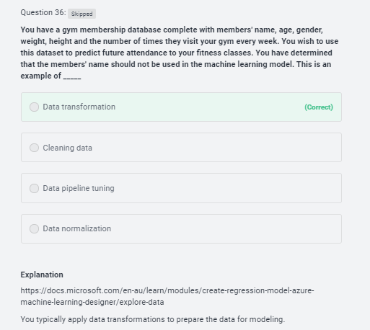
AI-900 Practice Question
timw.info/udemy

Slide 31
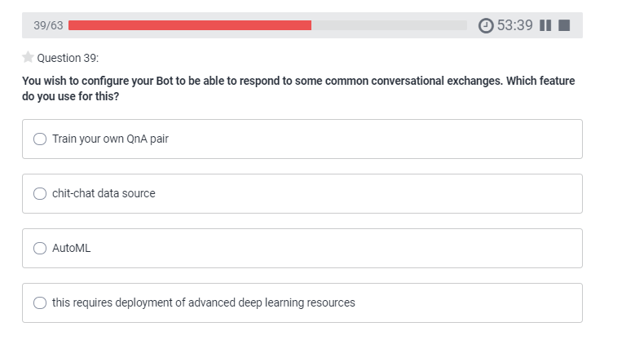
AI-900 Practice Question
timw.info/udemy

Slide 32
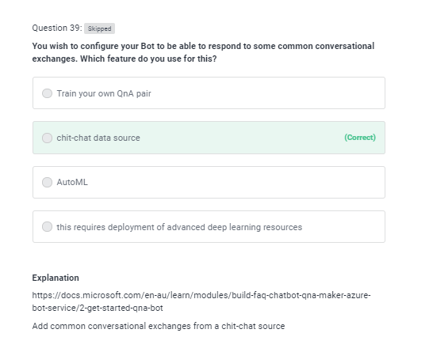
AI-900 Practice Question
timw.info/udemy

Slide 33
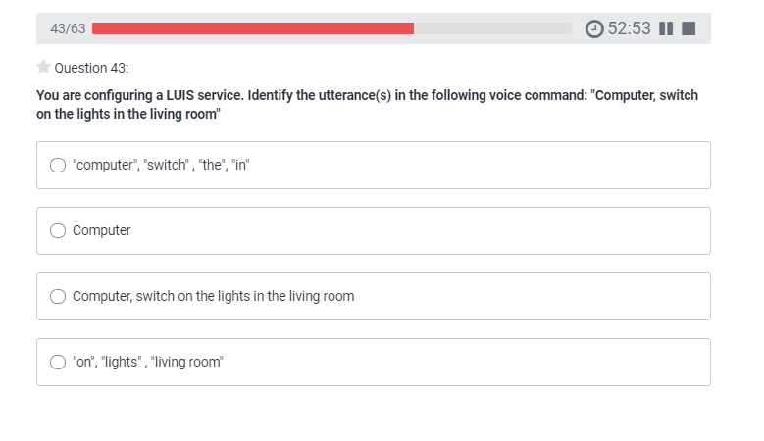
AI-900 Practice Question
timw.info/udemy

Slide 34
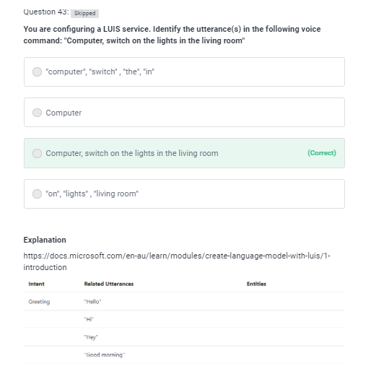
AI-900 Practice Question
timw.info/udemy

Slide 35
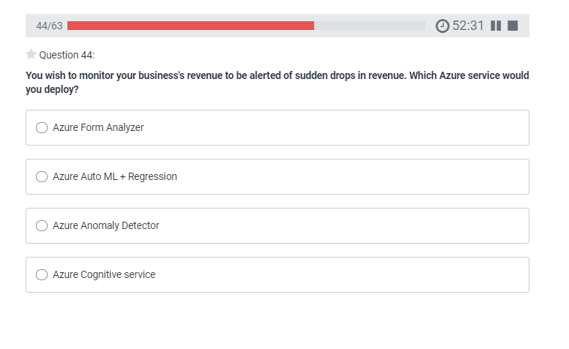
AI-900 Practice Question
timw.info/udemy

Slide 36
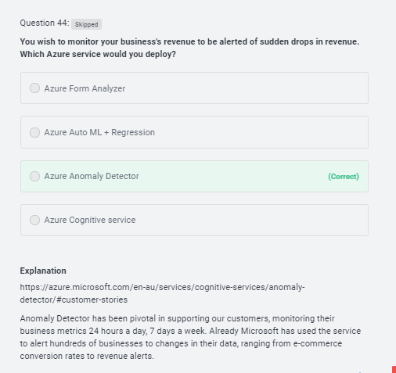
AI-900 Practice Question
timw.info/udemy

Slide 37
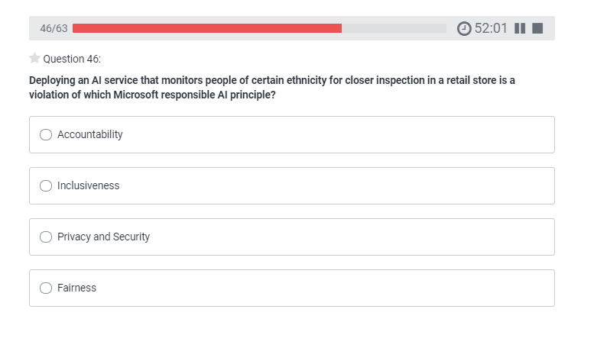
AI-900 Practice Question
timw.info/udemy

Slide 38
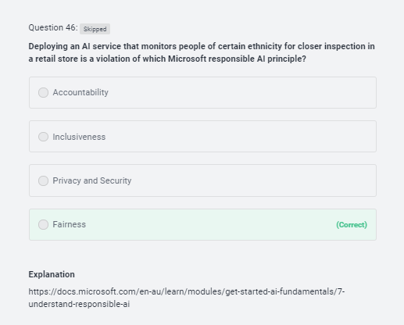
AI-900 Practice Question
timw.info/udemy

Slide 39
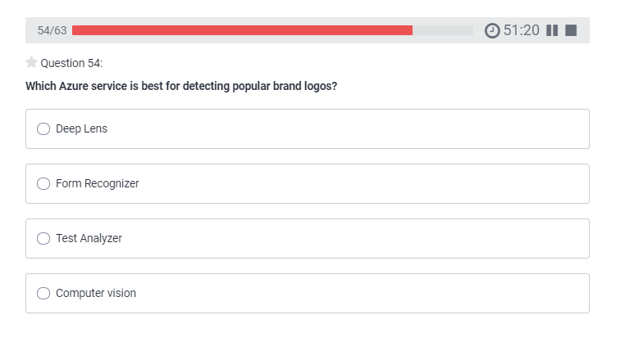
AI-900 Practice Question
timw.info/udemy

Slide 40
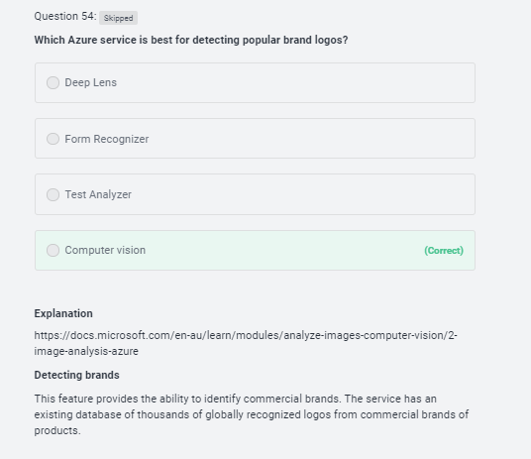
AI-900 Practice Question
timw.info/udemy

Slide 41
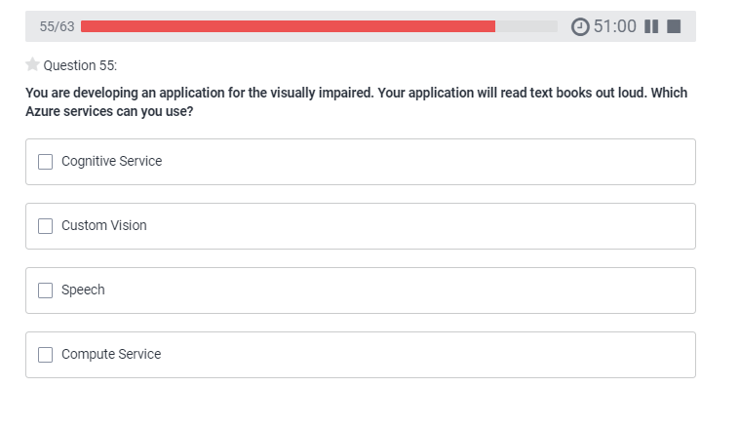
AI-900 Practice Question
timw.info/udemy

Slide 42
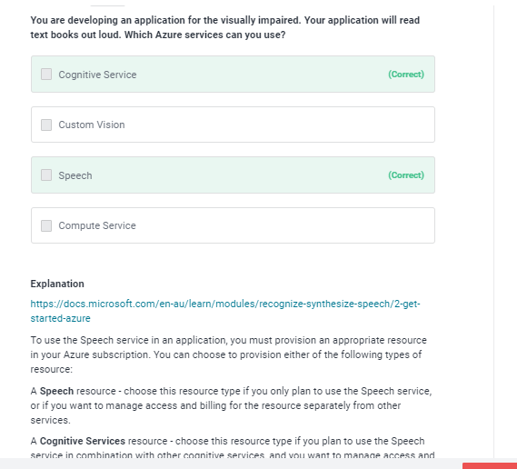
AI-900 Practice Question
timw.info/udemy

Slide 43
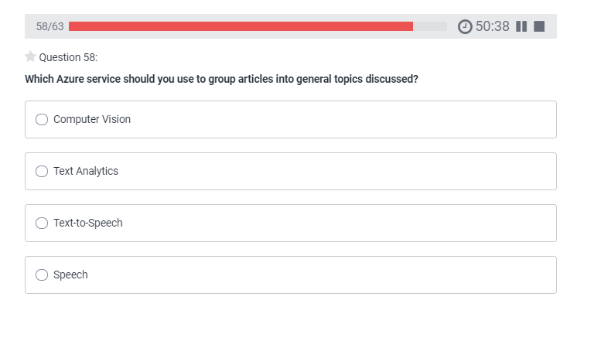
AI-900 Practice Question
timw.info/udemy

Slide 44
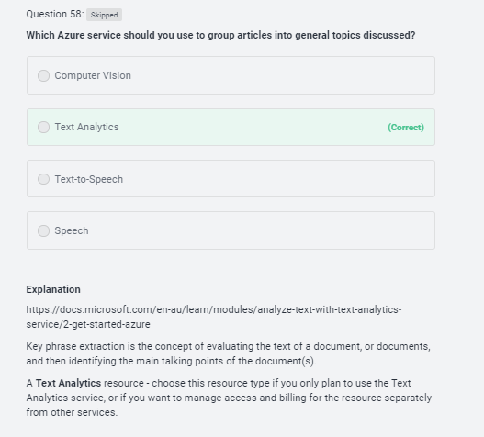
AI-900 Practice Question
timw.info/udemy

Slide 45
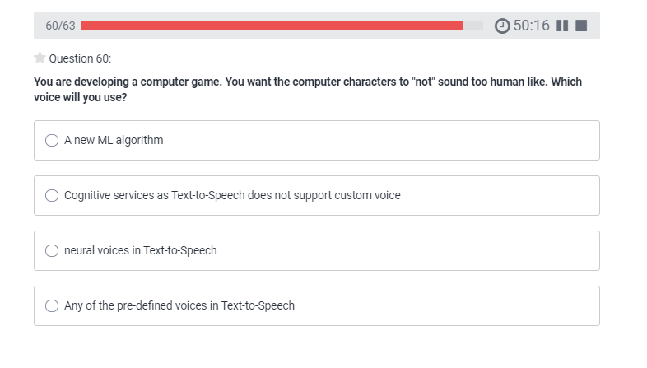
AI-900 Practice Question
timw.info/udemy

Slide 46
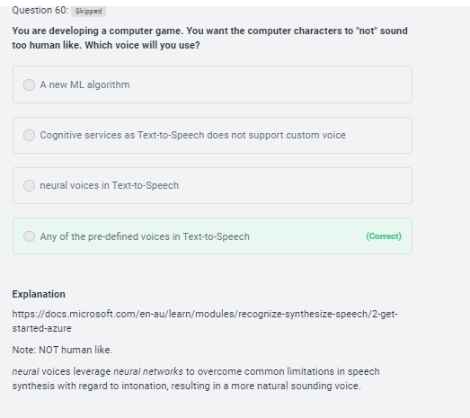
AI-900 Practice Question
timw.info/udemy

Slide 47
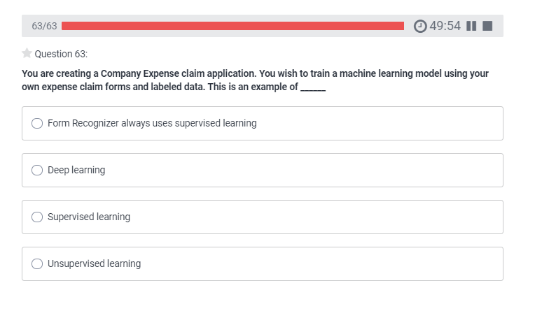
AI-900 Practice Question
timw.info/udemy

Slide 48
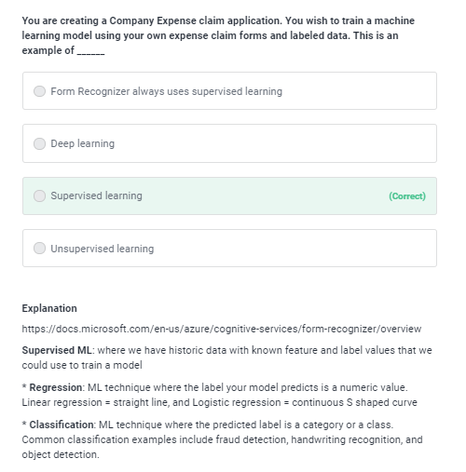
AI-900 Practice Question
timw.info/udemy

Slide 49
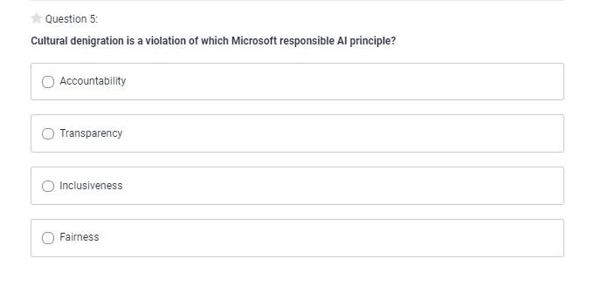
AI-900 Practice Question
timw.info/udemy

Slide 50
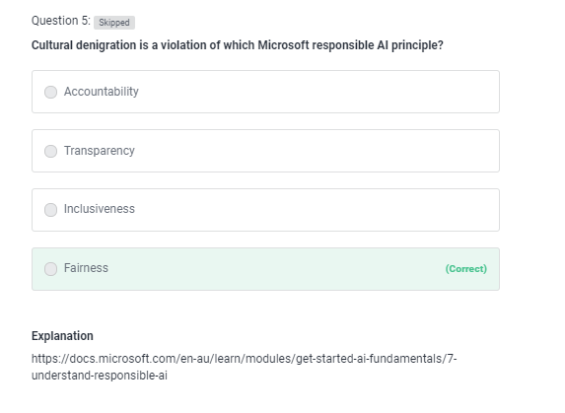
AI-900 Practice Question
timw.info/udemy

Slide 51
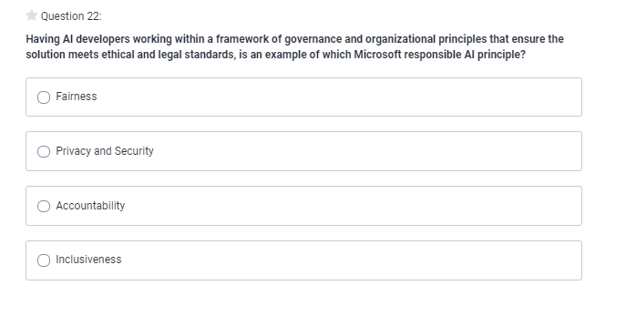
AI-900 Practice Question
timw.info/udemy

Slide 52
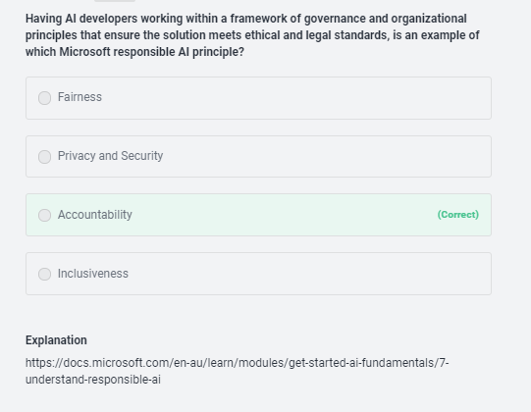
AI-900 Practice Question
timw.info/udemy

Slide 53
Thank you!
Course materials: timw.info/ai900
Twitter: @TechTrainerTim
Courses: timw.info/ps
Web: TechTrainerTim.com

Slide 54
Fundamental Terminology

Slide 55
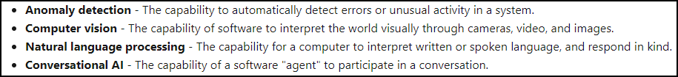
Artificial Intelligence (AI)
Any technique that enables computers to mimic human intelligence
https://timw.info/2bdb4

Slide 56
Machine Learning (ML)
Subset of AI that includes techniques that enable machines to improve at tasks with experience
The system "learns" without being explicitly programmed to do so
Supervised
Unsupervised

Slide 57
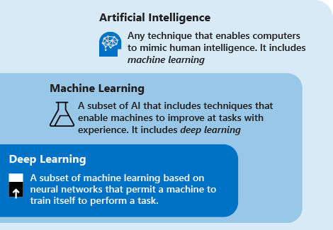
AI Schema
https://timw.info/c7769

Slide 58
Azure AI Technology Stack Overview

Slide 59
Azure AI Stack
Apache Spark on Azure (MMLSpark)
HDInsight
Databricks
Azure Machine Learning
Azure Cognitive Services
Azure Cognitive Search
Azure Bot Service

Slide 60
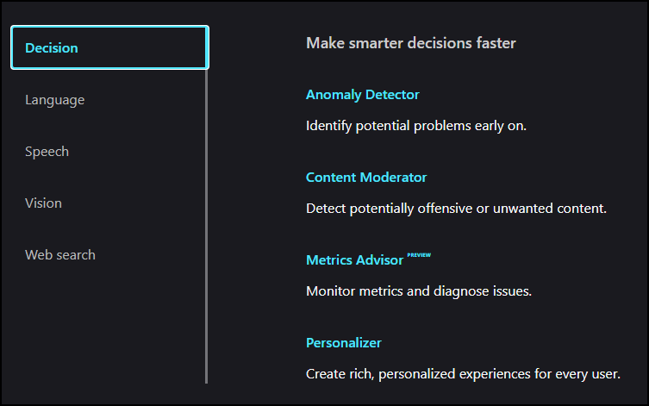
Azure Cognitive Services
Prediction
https://timw.info/b3f9f

Slide 61
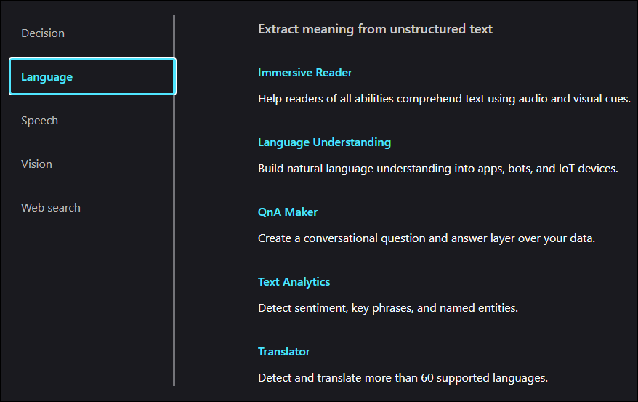
Azure Cognitive Services
Natural Language Processing (NLP)
https://timw.info/b3f9f

Slide 62
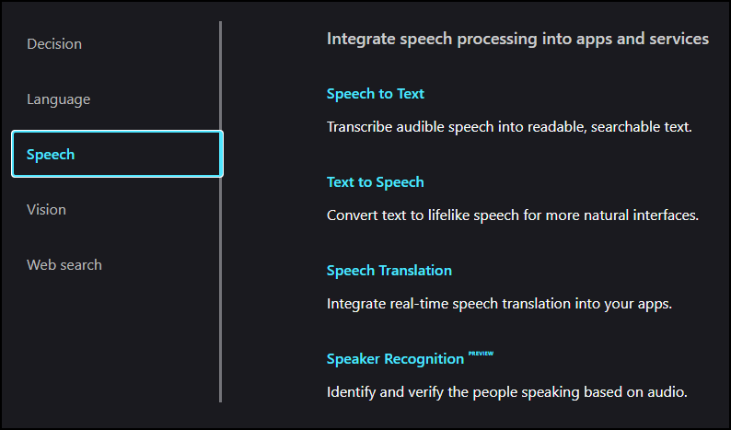
Azure Cognitive Services
Conversational AI
https://timw.info/b3f9f

Slide 63
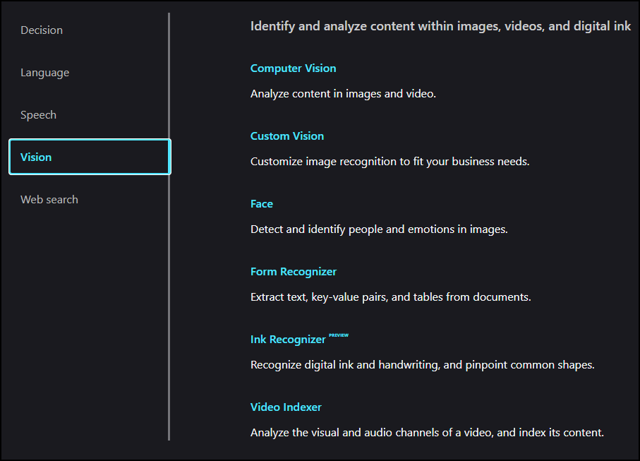
Azure Cognitive Services
https://timw.info/b3f9f

Slide 64
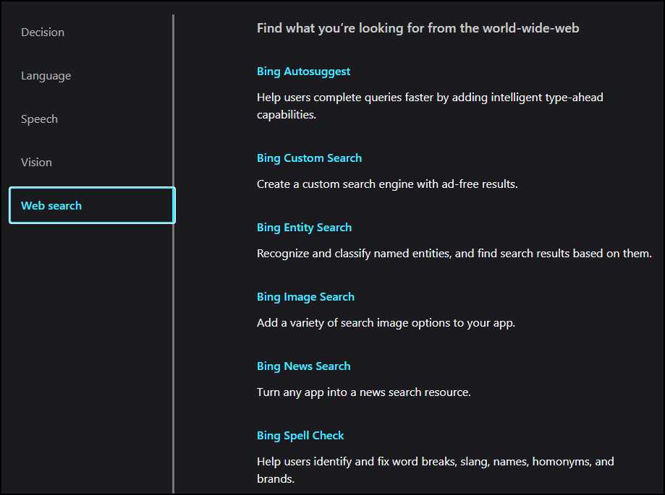
Azure Cognitive Services
https://timw.info/b3f9f

Slide 65
Use Cases

Slide 66
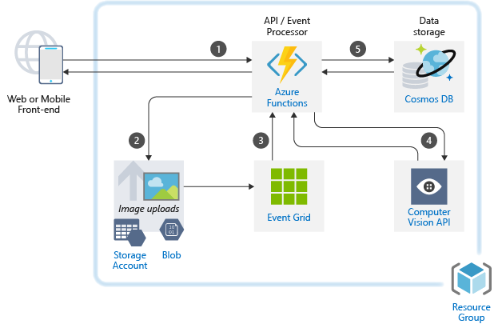
Image Classification
https://timw.info/caa25

Slide 67

Newsfeed Ingestion
https://timw.info/c0015

Slide 68

Internet of Things (IoT)
https://timw.info/3f2c0

Slide 69
Responsible AI

Slide 70
Microsoft's Position on AI Use
"We are committed to the advancement of AI driven by ethical principles that put people first."
Reference: https://timw.info/01bdb

Slide 71

Responsible AI Principles
AI systems should treat all people fairly
AI systems should perform reliably and safely
AI systems should be secure and respect privacy
AI systems should empower everyone and engage people
AI systems should be understandable
Examples: https://timw.info/rai
People should be accountable for AI systems
https://timw.info/880e4

Slide 72


Responsible AI
Compliance Manager
https://timw.info/84db2

Slide 73
Azure Machine Learning

Slide 74
Machine Learning (ML)
Subset of AI that includes techniques that enable machines to improve at tasks with experience
Supervised
Regression: Predicting numeric data
Classification: Organizing non-numeric, discrete data
Unsupervised
Clustering
Pattern recognition

Slide 75

ML Model
Feature (Descriptive attribute) engineering vs. feature selection
Label: What you're trying to forecast
https://timw.info/37a04

Slide 76

Azure Machine Learning Service
https://timw.info/de625

Slide 77

Blob Storage and Data Lake Storage
CSV, JSON
https://timw.info/772f8

Slide 78

Azure ML Dataset & Datastore
A reference to your dataset in Azure storage
Authenticated context
https://timw.info/a1df2

Slide 79

Azure ML Dataset & Datastore
https://timw.info/5a306

Slide 80

Azure ML Pipeline
https://timw.info/d572e

Slide 81

HTTP Methods
https://timw.info/cc6b1

Slide 82

How a REST API Works
CRUD
https://timw.info/a850d

Slide 83


How a REST API Works
https://timw.info/d7a91

Slide 84

Azure Automated ML
Build ML models in a much more efficient manner
https://timw.info/aai3

Slide 85

Validating AutoML Models
Confusion matrix
https://timw.info/26d20

Slide 86

Validating AutoML Models
Confusion matrix
https://timw.info/26d20

Slide 87
Computer Vision

Slide 88
Computer Vision Capabilities
Detect objects in images
Optical Character Recognition
Apply content tags to images
Detect faces in images

Slide 89
Software Development Kits (SDKs)
.NET
Python
Java
Node
Go

Slide 90
Exam AI-900 Strategy

Slide 91
Tim's Certification Study Pyramid
Interdependence
Content knowledge
Practical application
Test-taking skills

Slide 92
Item Types

Slide 93

Single Answer Multiple Choice

Slide 94

Multiple Answer Multiple Choice

Slide 95
Repeated Scenario
You need to move an Azure VM to another hardware host.
Solution: You redeploy the VM.
Does this solution meet the goal?
Yes
No

Slide 96
Repeated Scenario
You need to move an Azure VM to another hardware host.
Solution: You enable boot diagnostics.
Does this solution meet the goal?
Yes
No

Slide 97

Select and Place

Slide 98

Build List and Reorder

Slide 99

Active Screen/Fill in the Blank

Slide 100

Case Study

Slide 101






Performance-Based Lab

Slide 102
Microsoft Online Testing

Slide 103
Tim's Online Testing Video (YouTube)
timw.info/online

Slide 104

Microsoft Online Testing Process

Slide 105

Microsoft Online Testing Process

Slide 106

Microsoft Online Testing Process

Slide 107

Microsoft Online Testing Process

Slide 108

Microsoft Online Testing Process

Slide 109

Microsoft Online Testing Process

Slide 110

Microsoft Online Testing Process

Slide 111
Azure Cognitive Services

Slide 112


First Things First
Cognitive Services multi-service account
Azure Functions
https://timw.info/89e3b

Slide 113


How To Know Cognitive Services

Slide 114


How To Know Cognitive Services

Slide 115
Computer Vision
Digital Asset Management (DAM) solution for image data
Detect objects and features
Detect corporate brands/logos
Describe an image
Optical character recognition (OCR)
Generate thumbnail
https://timw.info/bb965

Slide 116

Face
Facial recognition
Facial verification
Emotion recognition
Person Group containers:
Person Group (10,000 persons)
Large Person Group (1M persons)
https://timw.info/31118

Slide 117

Video Indexer
Extract meaning from video and audio files
Index faces and spoken words
Great for making content available to vision- or hearing-challenged users
Content moderation
Azure Media Services
Encoding
https://timw.info/d0b4b

Slide 118

Content Moderator
Checks text, image, and video content for potentially undesirable content
Profanity
Adult or "racy" content
https://timw.info/7eec2

Slide 119

Speech
Speech-to-text: Transcribe audio from >40 languages
Speaker recognition:
Voice signature
https://timw.info/18876

Slide 120

Text Analytics
Language detection
Sentiment analysis
Entity extraction
People
Places
Organizations
Objects
Translator: 60 languages
https://timw.info/87290

Slide 121

Azure Cognitive Search
https://timw.info/c6ab1

Slide 122

Bing Web Search
Retrieve answers from Bing search engine
Web pages
Images
Videos
News
https://timw.info/7640a

Slide 123
Azure Bot Service

Slide 124

What is a Bot?
Chatbot
Computer programmed designed to mimic human interaction
Turn based text/audio conversation
Alternative UI
Language Understanding Intelligent Service (LUIS)
Cortana

Slide 125

Azure Bot Service
Toolset to develop "intelligent agents"
Graphical:
Bot Framework Composer
Code:
Bot Framework SDK
C#, Python, JavaScript, Java
https://timw.info/87290

Slide 126

Chatbot
https://timw.info/b04eb

Slide 127

Conversational Bot
https://timw.info/32e9e

Slide 128
Monitoring

Slide 129

Azure Monitoring
https://timw.info/azmon

